Slide 1

Indian Institute of Information Technology Pune
Department of Computer Science Engineering 2022-2023
Project on
“Face Detection using Python and Machine Learning”
Name- Rao Suraj Rao
MIS-112015108
Mentor - Dr.Chandrakant Guled

Slide 2
Face Detection using OpenCV and python
Project Area :-
This project is based on face detection using python and libraries like opencv,numpy,matplotlib and haar feature based cascade classifier

Slide 3
Outline
Introduction
Motivation
Abstract
Scope
Advantages
Requirements and Installations
Information of algorithms used
Methodology
Source codes
Conclusion
References

Slide 4
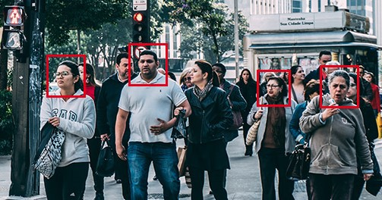
Introduction
Face detection is a computer vision technology that helps to locate/visualize human faces in digital images. This technique is a specific use case of object detection technology that deals with detecting instances of semantic objects of a certain class (such as humans, buildings or cars) in digital images and videos. With the advent of technology, face detection has gained a lot of importance especially in fields like photography, security, and marketing.

Slide 5
Motivation
This Face Detection Project is developed for our Security CCTV Police,our Indian army and even for common use of people to detect a face in single and group of people in Images. Today in the world, Security is advancing to detect the terrorist and criminals easily in crowd. This Project will easily detect faces even old\blur Images with very less time of execution. This Face Detection Code can be deployed and used in any application camera, security apps and website to find faces easily.

Slide 6
Abstract
This project gives an ideal way of detecting and recognizing human face using OpenCV, and python which is part of Machine learning. It contains the ways in which Machine learning, an important part of computer science field, can be used to determine the face using several libraries in OpenCV along with python. This System will contain a proposed system which will help in the detecting the human face in real time. This implementation can be used at various platforms in machines and smartphones, and several software applications.

Slide 7
Scope of the Project
To identify and verify terrorists at airports, railway stations and malls the face recognition technology will be the best choice in India as compared with other biometric technologies since other technologies cannot be helpful in crowded places.
This technology can also be used effectively in various important examinations such as SSC, HSC, Medical, Engineering, MCA, MBA, B- Pharmacy, Nursing courses etc. The examinee can be identified and verified using Face Recognition Technique.
It can also be deployed in police station to identify and verify the criminals.
It can also identify the number of students in a classroom. It can collect all the number of faces in less than 1 sec. Easy to take attendance.

Slide 8
Advantages of this Method
1. It can Detect faces easily with less time of execution.
2. It can Detect Face in any quality of Images even blur.
3. It can Detect single, double or even multiple faces in any Image.
4. It can tell the number of Peoples/faces in Image.
5. It is fully automatic face recognition system
6. It is one of the best in todays world Innovation as it uses shortest amount of code.
7. It uses Haar feature based Algorithm to detect which makes it very accurate and fast processing of face detection

Slide 9
OpenCV-Python
OpenCV essentially stands for Open Source Computer Vision Library. Although it is written in optimized C/C++, it has interfaces for Python and Java along with C++.
OpenCV-Python is the python API for OpenCV. You can think of it as a python wrapper around the C++ implementation of OpenCV. OpenCV-Python is not only fast but is also easy to code and deploy(due to the Python wrapper in foreground).

Slide 10
Requirements and Installation
Requirements for this project are: Python 2.7,3.7,OpenCV,Numpy,Haarcascade classifier
OpenCV-Python supports all the leading platforms like Mac OS, Linux, and Windows. It can be installed in either of the following ways:
Packages for standard desktop environments (Windows, macOS, almost any GNU/Linux distribution)
● run pip install opencv-python if you need only main modules
● run pip install opencv-contrib-python if you need both main and contrib modules

Slide 11
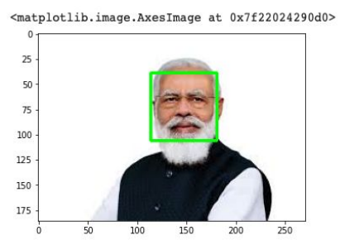
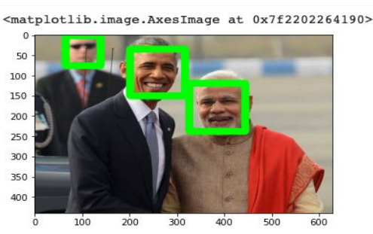
Face Detection
Face detection is a technique that identifies or locates human faces in digital images. Face recognition is the task of identifying an already detected object as a known or unknown face.

Slide 12
Face Detection Classifiers
Face detection is performed by using classifiers. A classifier is essentially an algorithm that decides whether a given image is positive(face) or negative(not a face). A classifier needs to be trained on thousands of images with and without faces. Fortunately, OpenCV already has two pre-trained face detection classifiers, which can readily be used in a program.
The two classifiers are:
1)Haar Classifier
2)Local Binary Pattern (LBP)
In this project we will be using the Haar Classifier as it is the best method for detection

Slide 13
Haar feature-based cascade classifier
This classifier is widely used for tasks like face detection in computer vision industry.
Haar feature-based cascade classifiers is an effective machine learning based approach, in which a cascade function is trained using a sample that contains a lot of positive and negative images.
We need to download trained classifier XML file (haarcascade_frontalface_default.xml)
We can find the necessary XML files at:
/home/<username>/.local/lib/<python-version>/site-packages/cv2/data/

Slide 14
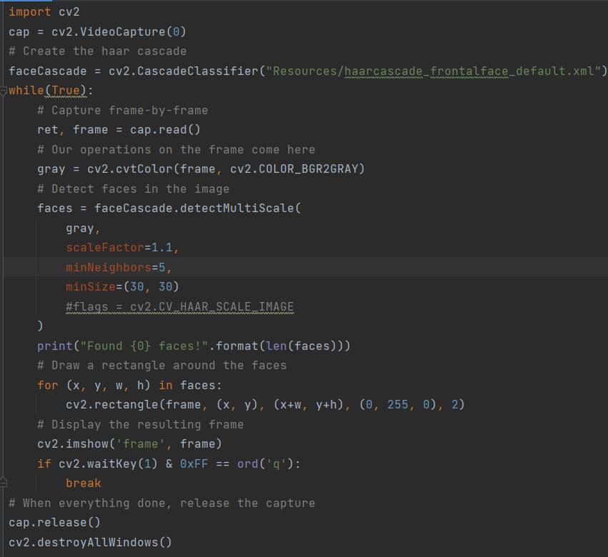
Steps to implement the process
Load the pre-trained haar classifier
haarcascade_frontalface_default.xml
Imports
Initialise the classifier
Apply face cascade on webcam
frames
Release the capture frames

Slide 15

Working of face detection

Slide 16
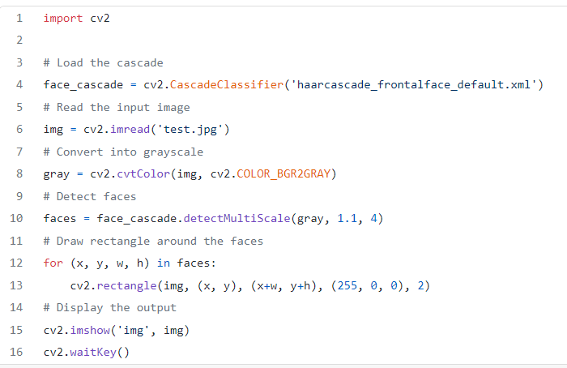
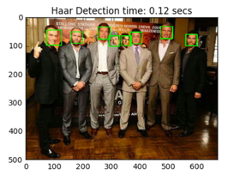
Source Code for detecting faces in images

Slide 17

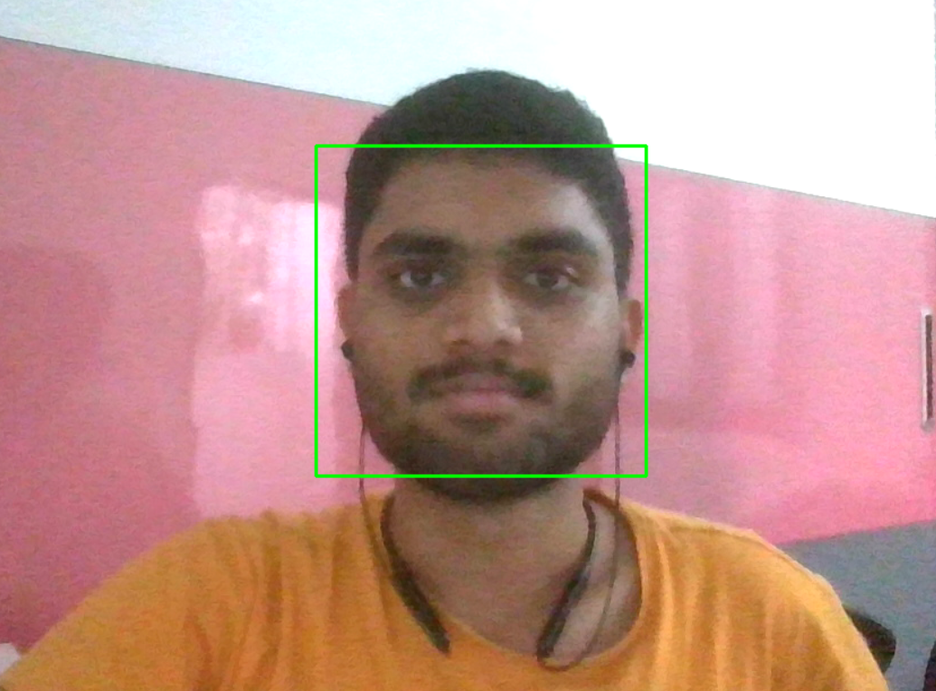
Source Code for detection of faces in videos
Videos are basically made up of frames, which are still images. So we perform the face detection for each frame in a video.

Slide 18
Conclusion
Face recognition technologies have been associated generally with very costly top secure applications. Today the core technologies have evolved and the cost of equipments is going down dramatically due to the integration and the increasing processing power. Certain applications of face recognition technology are now cost effective, reliable and highly accurate. As a result there are no technological or financial barriers for stepping from the pilot project to widespread deployment.
Government and NGOs should concentrate and promote applications of facial recognition system in India in various fields by giving economical support and appreciation

Slide 19
References
http://umpir.ump.edu.my/id/eprint/327/3/Real%20time%20face%20detec tion%20system%20-%20Chapter%201.pdf
https://www.sciencedirect.com/topics/computer-science/classifier-cascade
https://ieeexplore.ieee.org/document/6315916
https://link.springer.com/chapter/10.1007/978-3-642-72201-1_9
https://thesai.org/Downloads/Volume9No6/Paper_6-Study_of_Face_Recog nition_Techniques.pdf
http://www.pace.ac.in/documents/ece/FACE%20RECOGNITION%20SYSTE M%20WITH%20FACE%20DETECTION.pdf

